Slide 1
AFTERWORK MASCI
2 FEVRIER 2021

Slide 2
A Géotec Foundation ?
Why ?

Slide 3
A Géotec Foundation
Why ?
A response to the urgent need to take part in the struggle against inequalities and global warming.
A tool for mobilization to face societal challenges.
To be an actor in the center of the world, our country, our region, and our society.
We, GÉOTEC, have a role to play !

Slide 4
Géotec Foundation
3 action levels

Slide 5
Géotec Foundation
3 action levels
Assistance to people in difficulty for a better integration in society (health, disability, people without training, far from employment, ...) in France.
Assistance to West African populations, mainly to support literacy, water and electricity access.
Fight against global warming

Slide 7
Géotec Foundation : 3 action levels
❶ Assistance to people in difficulty for a better integration in society (health, disability, people without training, far from employment, ...) in France.
Some figures
The Orientation Council for Employment (COE) report about " the sustainable distancing from the labor market" in 2014 indicates that this situation involves about 2 million people - "the equivalent of 6.5% of the active population".
Activity, employment and unemployment of disabled people (%)
 | People recognized as disabled | In general
Activity rate | 43 | 72
Employment rate | 35 | 64
Unemployment rate | 19 | 10
Source : INSEE, 2015 data for 15-64 year olds
At 19%, the unemployment rate for disabled people is twice the national average.

Slide 8
Géotec Foundation : 3 action levels
❶ Assistance to people in difficulty for a better integration in society (health, disability, people without training, far from employment, ...) in France.
Distance from employment : a key aspect in the fight against precariousness
At least 2 million people are currently unemployed (3% of the population) :
Long-term unemployed people.
People receiving minimum social benefits.
Disabled unemployed people.
Unemployed and out-of-school young people (More than one young people out of seven were "neither in school, nor in employment, nor in education" in France in 2018, so 963,000 people).
People without resources
People living in a sensitive area.
Isolated parents.
People who arrived in France recently.
People under criminal justice control, etc.

Slide 10
Géotec Foundation : 3 action levels
❷ Assistance to disadvantaged populations in West Africa, mainly to support literacy, access to water and electricity.
West Africa,
the most inequitable region on the continent
Today, the 1% richest West Africans earn more than the rest of the population.
Africa's poverty rate declines,
but the number of poor people increases
More than 500 million Africans live below the poverty level, or with less than 2 dollars a day.
Source : « Le Monde juillet 2019 »

Slide 11
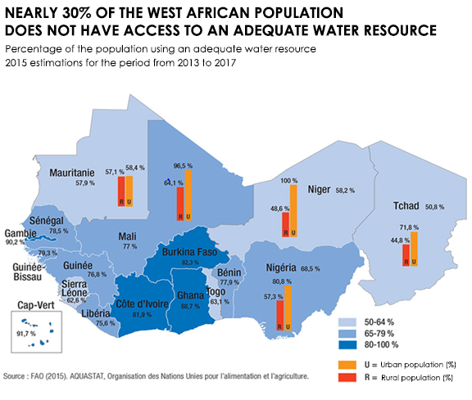
Géotec Foundation : 3 action levels
❷ Assistance to disadvantaged populations in West Africa, mainly to support literacy, access to water and electricity.

Slide 12
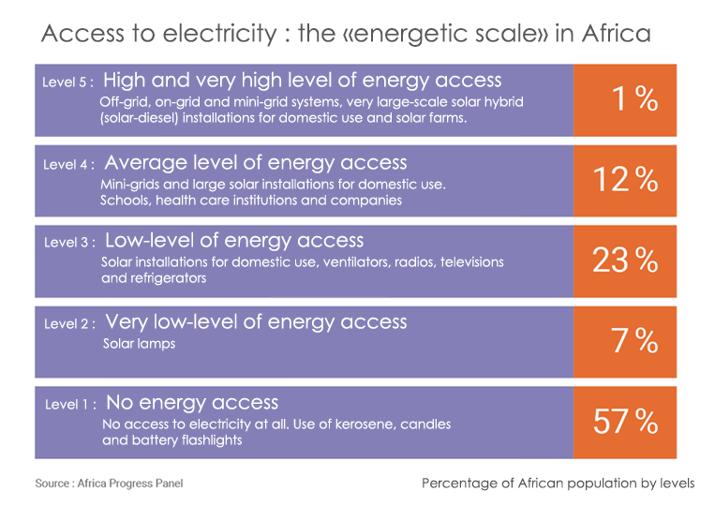
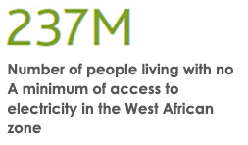
Géotec Foundation : 3 action levels
❷ Assistance to disadvantaged populations in West Africa, mainly to support literacy, access to water and electricity.

Slide 14
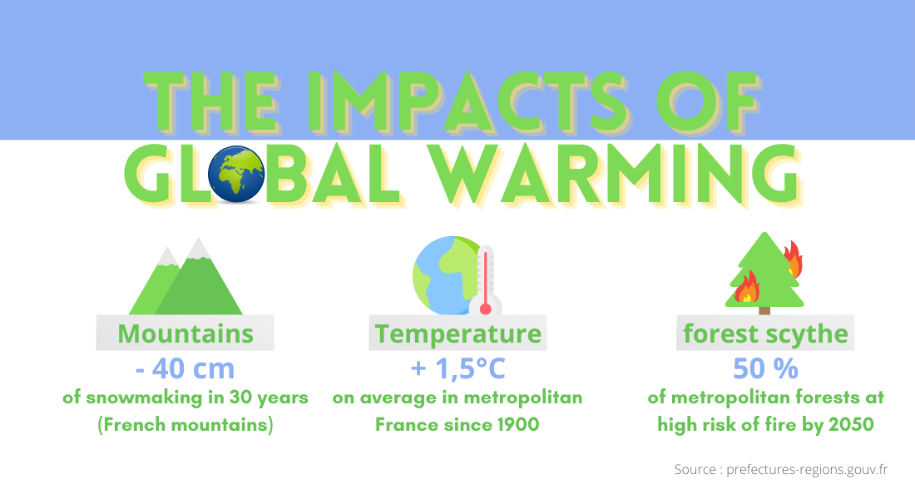
Géotec Foundation : 3 action levels
❸ Fight against global warming.

Slide 15
Géotec Foundation
All actors

Slide 16
Géotec Foundation
All actors
Importance of collective mobilization.
Commitment to the company.
To initiate partnerships between your company and associations.
Contribute actively to the CSR process of the company.
GÉOTEC financing: 50 to 150 k€ per year on different projects.

Slide 17
Géotec Foundation
Organization

Slide 18
Géotec Foundation
Organization
FOUNDATION supported by the Fondation De France.
An executive committee with 8 people : 5 people from the company from the 4 regions and 3 external people.
Request for projects submitted to the committee, then after approval, validation and funding.

Slide 19
Géotec Foundation
And you ?

Slide 20
Géotec Foundation
And you ?
Why should you get involved - What's the benefit?
Personal development
Not simply an altruistic behavior, but a way to enrich and give sense to your life by getting involved in a meaningful mission: Getting involved makes you feel useful to society while acquiring knowledge.
Getting involved makes you happy! Happy to help the suffering people, happy to feel helpful, happy to improve the society.
"The happiest man is the one who brings happiness to a higher number of people" Diderot.
A way to escape daily routine.
An opportunity to get out of your comfort zone by taking the time to meet new people. A way to escape and not getting bored.
Above all an undeniable advantage to acquire or develop skills that will be good references on a resume. Altruistic projects meaning competencies for companies. A beneficial experience to perfect your team spirit and increase your adaptation capacities.

Slide 21
Géotec Foundation
How ?

Slide 22
Géotec Foundation
How ?
❶ Identify and support a project.
I have a project that is important to me.
I ensure that it is in accordance with the Geotec Foundation's guidelines.
I send a precise and concrete description (give the contact point and where to send the project) via the committee manager of my region.
I may have to come to present the project and the association in front of the committee.
I follow the evolution of the project with a person of the committee.
❷ Participate in the financing by making a donation to the GÉOTEC FOUNDATION.

Slide 23
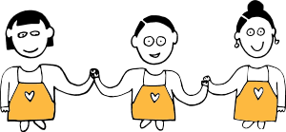
Géotec Foundation
How ?
Exemple : Café Joyeux
2016 Association : observes 700 000 autistic people, 2 x more unemployment, only 0.5% work in an ordinary environment.
Objective
Giving some work to people who are often invisible, and, in the same way, to give them back their self-confidence and dignity.
Achievements
3 Cafés Joyeux opened (1 à Rennes fin 2017, 2 à Paris début 2018).
22 cooks and waiters work on permanent contracts in addition to 5 supervising managers.
At the end of 2018, Café Joyeux launches its own coffee grains and capsules brand.
Projects
Opening a Café Joyeux in Versailles at the end of 2020.
Total budget : 350 kϵ for the goodwill
and 200-300kϵ for works and equipment
Employment of 7-9 disabled people and 2-3 supervisors.

Slide 24
Géotec Foundation
Emergency

Slide 25
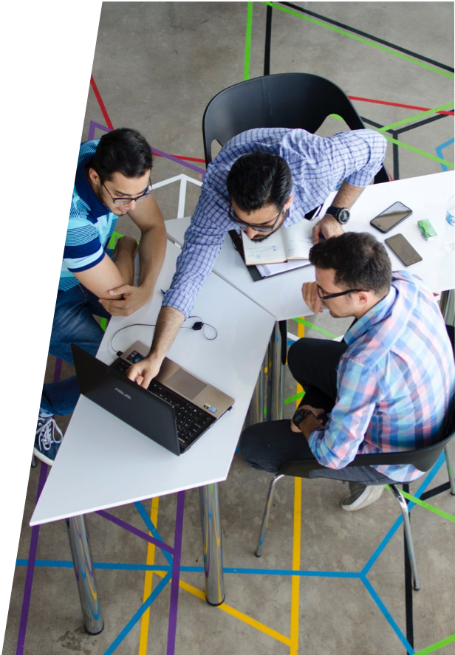
Géotec Foundation
Emergency
If we want this to change
TOGETHER,
Let’s go to the next level.

Slide 26
Géotec Foundation
Your contacts

Slide 27
Géotec Foundation
Your contacts
YOUR REGIONAL CONTACTS
Northwest Region Christophe LAURENT christophe.laurent@geotec.fr
South-West Region Océane DART oceane.dart@geotec.fr
North-east region Lydie AZEVEDO lydie.azevedo@geotec.fr
South-East region Jean-Yves LACOMBE jean-yves.lacombe@geotec.fr
CONTACT GÉOTEC FOUNDATION : fondation@geotec.fr
WEBSITE OF THE FONDATION DE FRANCE (description of the GÉOTEC FOUNDATION and donations)
https://www.fondationdefrance.org/fr/node/8991

Slide 28
AFTERWORK MASCI
2 FEVRIER 2021

